Slide 1
BIKES
BY
SUSHIL VARMA

Slide 2
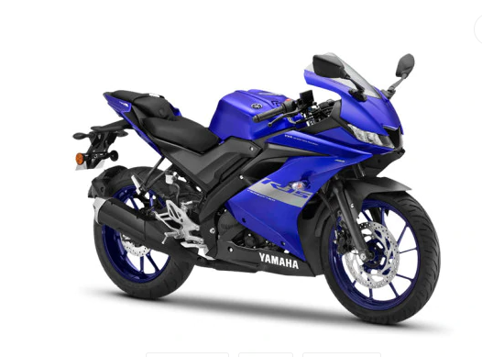
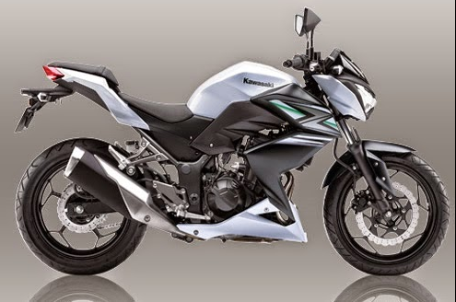
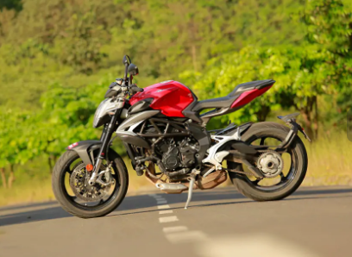
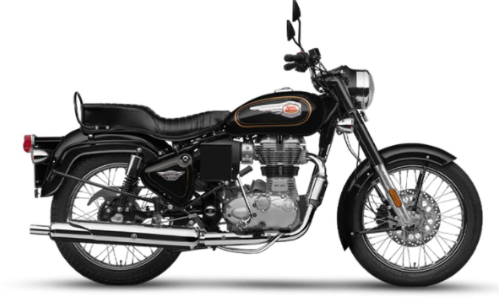
BIKE MODELS
YAMAHA
KAWASAKI
AGUSTA
ROYAL ENFIELD

Slide 3
YAMAHA
MODEL :YAMAHA YZF R15
ENGINE : 155 CC
WEIGHT : 142 KG
PRICE : 1.5 LAKH

Slide 4
KAWASAKI
MODEL :KAWASAKI Z250
ENGINE : 250 CC
WEIGHT : 168 KG
PRICE : 6 LAKHS

Slide 5
AGUSTA
MODEL :AGUSTA MV 800
ENGINE : 798 CC
WEIGHT : 175 KG
PRICE : 15 LAKHS

Slide 6
ROYAL ENFIELD
MODEL :ROYAL ENFIELD 350
ENGINE : 346 CC
WEIGHT : 191 KG
PRICE : 1.3 LAKH

Slide 7
THANK YOU

